Slide 1
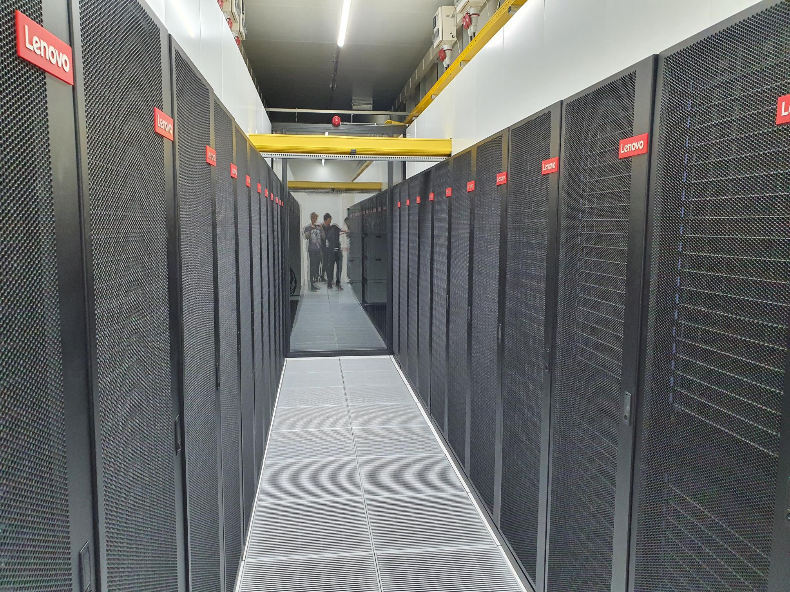

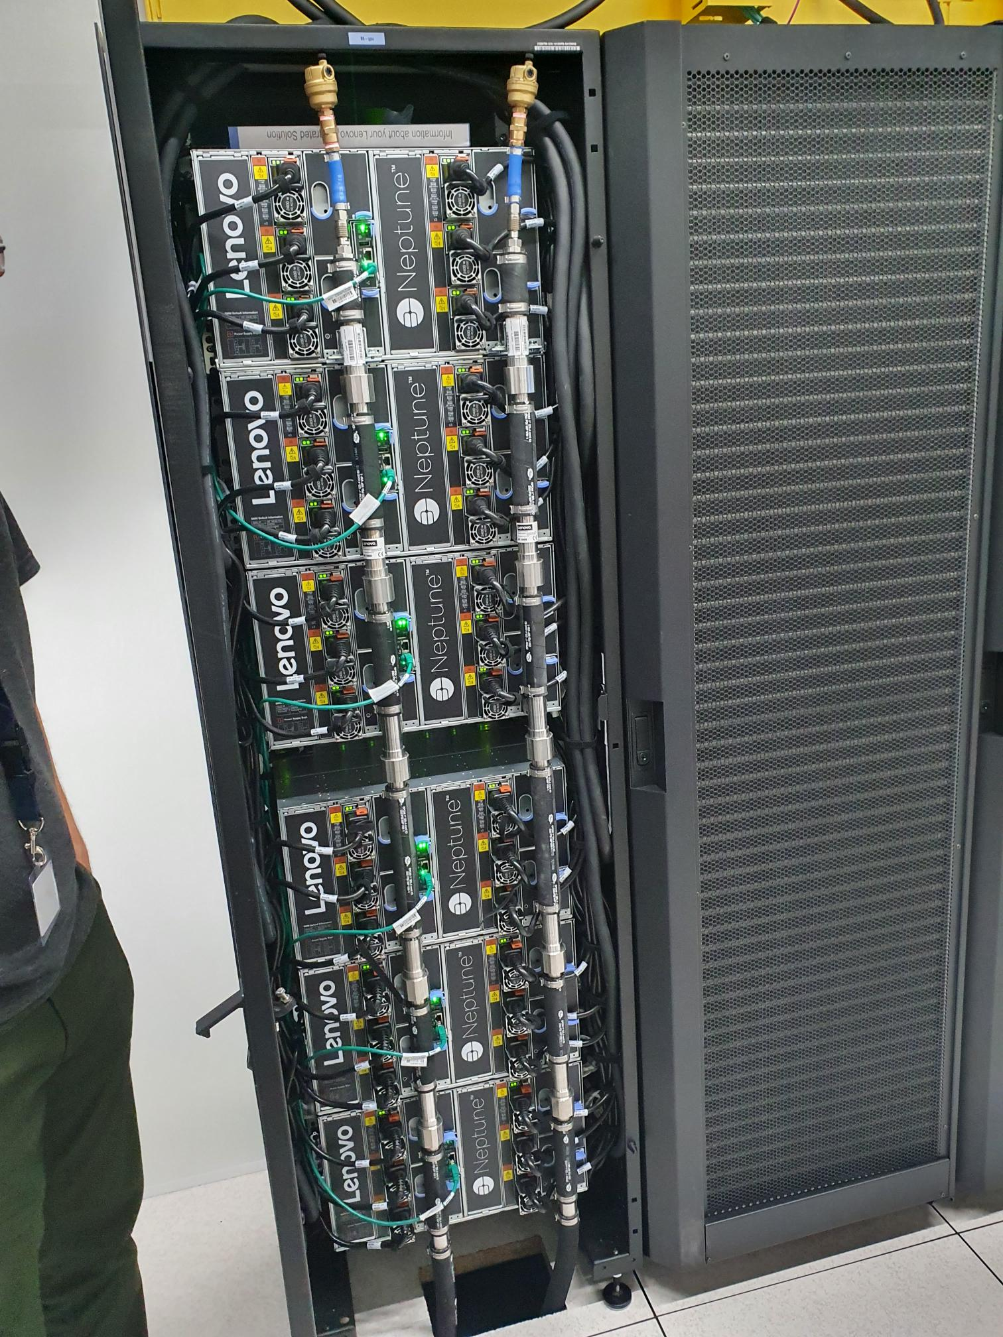
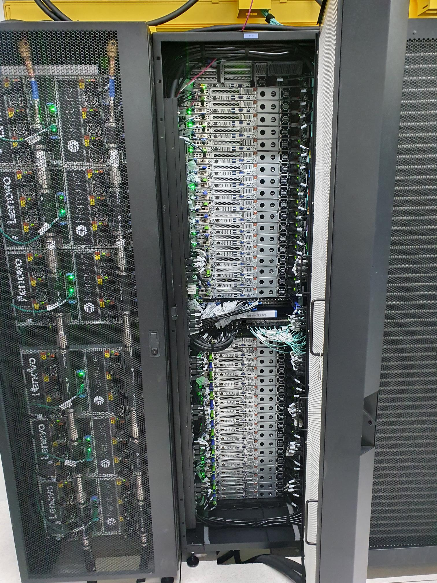

High-Performance Machine-Learning
Robert Jan Schlimbach
Team High-Performance Machine-Learning

Slide 2

In this presentation
Making (AI) workloads go fast
Warning: this will be messy
Material is available at https://github.com/SURF-ML/HPML-course-materials

Slide 3
In this presentation
Please:
Interrupt me if you have a question
Let me know if something is unclear (it’s probably me, not you)

Slide 4

Chapter orange
Macro

Slide 5

Who am I
Robert Jan:
UvA CS&AI grad
HPC ML advisor at SURF
Love making code go fast
Love running, climbing, and mountains
SURF
Help academia in a very broad sense
Eduroam, SurfConext, SurfMarket, National Supercomputer, etc...
Collaborate a lot in (Inter-)National projects
Bulwark against our Microsoft overlords
High-Performance Machine-Learning group
Very diverse set of people interested in everything AI & Science & HPC & …

Slide 6
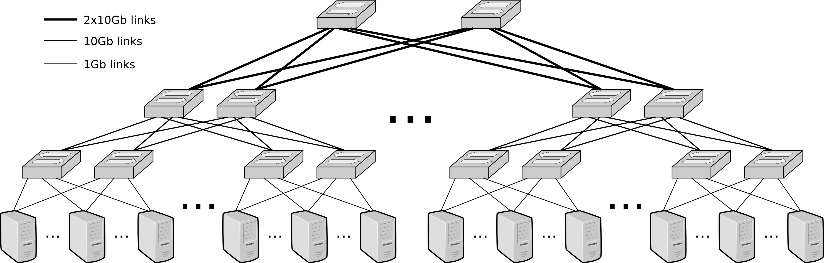
Snellius
~1300 CPU-based nodes
128-192 cores
256-378 GB RAM
~100 high-memory nodes
1TB-8TB RAM
160 GPU nodes
x4 nvidia A100s / H100s
512GB RAM
40GB /94 GB VRAM
Storage:
~13PB of medium-speed storage project space
720TB of home-dir
210TB of NVME
Interconnect: 100GBps Infiniband fat-tree

Slide 7
Access mechanisms
Direct access through institute
NWO small: <=1M SBUs, <= 10TB storage
NWO big: >1M SBUs, >10TB storage
LUMI access through SURF
LUMI/MN5/Leonardo/Jupiter: through EuroHPC
We also offer Spider HTC (‘small compute & large data) and HPC Cloud (‘always on’) and dCache (data caching)
We offer consultancy!
4 hours ‘default’
Up to 160 hours ‘if we think your project is important’
NWO large: a lot

Slide 8
Chapter orange
Micro: fast(er) code

Slide 9
The three S'
Know your System
What kind of hardware do I have?
What features does my hardware support?
Know your Software
Does my software do what I want to do efficiently?
Does my software support my hardware features?
Know your Stack
What version of software am I running?
Is my stack compiled for my hardware?

Slide 10
System
Which CPUs?
Architectures: X86_64, ARM64
What kind of storage?
SSD, HDD, Tape?
SATA, NVMe or full PCI-E, Network?
What kind of Networking?
Ethernet? InfiniBand (IB)?
IOPs vs Throughput
What kind of RAM?
High Bandwidth Memory (HBM) or Double Data Rate (DDR)?
How much? Enough for a RAMdisk? (/dev/shm)
You (AI person) are always memory limited
Which GPUs?
AMD? Good raw performance, PyTorch support is improving
NVIDIA? Optimized for AI with good PyTorch support.
Intel? Technically supported in PyTorch.
https://servicedesk.surf.nl/wiki/display/WIKI/Snellius+hardware+and+file+systems

Slide 11
System
Goals:
Understand what hardware bottlenecks could be limiting
Understand pro’s and con’s of various hardware
Know how to choose appropriate hardware for you DL task
Know what to do to mitigate bottlenecks

Slide 12
Fundamental bottlenecks
E.g. training a compute intensive network on a single node
Compute (floating point operations per second, FLOPS)
Memory bandwidth
Memory size
I/O
Communication

Slide 13
Fundamental bottlenecks
Compute (floating point operations per second, FLOPS)
Memory bandwidth
Memory size
I/O
Communication
Data needs to get to the processor in time in order to do compute!
Many codes are limited by memory bandwidth

Slide 14
Fundamental bottlenecks
Compute (floating point operations per second, FLOPS)
Memory bandwidth
Memory size
I/O
Communication
(may be) limited by memory:
Deep/wide networks
Networks with very large input/output layers (e.g. high res images)
Not a performance bottleneck, but a no-go!
But: unified memory

Slide 15
Fundamental bottlenecks
Compute (floating point operations per second, FLOPS)
Memory bandwidth
Memory size
I/O
Communication
HPC systems typically have shared file systems
Good bandwitdh
(relatively) low I/O operations per second (IOPS)
Common bottleneck in distributed learning! Many nodes reading from the same filesystem.
Other users (& sysadmins) will dislike you if you do I/O in a naive way!

Slide 16
Fundamental bottlenecks
Compute (floating point operations per second, FLOPS)
Memory bandwidth
Memory size
I/O
Communication
Communication can be limiting in several ways:
Latency (many, small message send between nodes)
Bandwidth (few, large messages send between nodes)
Load imbalance (some workers in distributed job are slower / have more work; others have to wait when synchronization is needed)
CPU <-> GPU sync

Slide 17
Some context
What? | Time | Equivalent to N CPU instructions
CPU instruction | 0.25 ns (@4GHz) | 1
GPU instruction | 1 ns (@1 GHz) | 4
Fetch from L1 CPU cache | 0.5 ns | 2
Fetch from L2 CPU cache | 7 ns | 28
Fetch from main CPU memory | 100 ns | 400
CPU => GPU latency (PCI) | 300 ns | 1200
GPU ⬄ GPU latency (NVLink) | 300 ns | 1200
Infiniband network latency | 1 μs | 4k
Ethernet network latency | 10-1000 μs | 40k-4M
Seek time (NVMe SSD) | 20 μs | 80k
Seek time (Sata SSD) | 200 μs | 800k
Seek time (hard disk) | 2-5 ms | 8-20M
Network File System (NFS) response times | 10-40 ms | 40-120M
Robot Fetch time (Tape) | +- 60 s | 180B

Slide 18
Chapter orange
Micro: compute

Slide 19
Hardware overview
 | FP4 [TFLOPS] | FP8 [TFLOPS] | INT8 [TOPS] | FP16/BF16 [TFLOPS] | FP32 [TFLOPS] | FP64 [TFLOPS] | Memory [GB] | Memory Bandwidth [GB/s] | PCIe [GB/s] | Power draw [W] | FP16 TFLOP per Watt
AMD MI250 |  |  | 362.1 | 362.1 | 90.5 | 90.5 | 128 | 3276.8 | 31.51 | 560 | 0.64
AMD MI325x |  | 2615 | 2615 | 1307 | 654 | 163 | 256 | 6000 | 128 | 1000 | 1.3
NVIDIA A100 |  |  | 624 | 312 | 156 | 19.5 | 40/80 | 1555-2039 | 64 | 400 | 0.78
NVIDIA H100 |  | 1979 | 1979 | 990 | 495 | 67 | 80/96 | 2000-3900 | 128 | 700 | 1.32
NVIDIA GB200 | 20,000 | 10,000 | 10,000 | 5,000 | 2,500 | 90 | 384 | 16,000 | 256 | 2700 | 1.85
NVIDIA L40S (inference only) |  | 733 | 733 | 362 | 183 | 1.4 | 48 | 864 | 64 | 350 | 1.03
NVIDIA RTX 5090 (consumer) | 1676 | 838 | 838 | 420 | 105 | 1.6 | 24 | 1790 | 128 | 575 | 0.73
Intel Xeon Scalable 8180 (per socket) |  |  | - | - | 4.2 | 2.1 | 768 (max) | 119 (max) | 15.75 | 205 | 0.02
AMD EPYC 7601 (per socket) |  |  | - | - | 1.4 | 0.69 | 2000 (max) | 159 (max) | 15.75 | 180 | 0.008
Notes:
Add H100, add watt en perf per watt, add a10 inference

Slide 20
Hardware overview
GPUs support reduced precision, which has higher performance
 | FP4 [TFLOPS] | FP8 [TFLOPS] | INT8 [TOPS] | FP16/BF16 [TFLOPS] | FP32 [TFLOPS] | FP64 [TFLOPS] | Memory [GB] | Memory Bandwidth [GB/s] | PCIe [GB/s] | Power draw [W] | FP16 TFLOP per Watt
AMD MI250 |  |  | 362.1 | 362.1 | 90.5 | 90.5 | 128 | 3276.8 | 31.51 | 560 | 0.64
AMD MI325x |  | 2615 | 2615 | 1307 | 654 | 163 | 256 | 6000 | 128 | 1000 | 1.3
NVIDIA A100 |  |  | 624 | 312 | 156 | 19.5 | 40/80 | 1555-2039 | 64 | 400 | 0.78
NVIDIA H100 |  | 1979 | 1979 | 990 | 495 | 67 | 80/96 | 2000-3900 | 128 | 700 | 1.32
NVIDIA GB200 | 20,000 | 10,000 | 10,000 | 5,000 | 2,500 | 90 | 384 | 16,000 | 256 | 2700 | 1.85
NVIDIA L40S (inference only) |  | 733 | 733 | 362 | 183 | 1.4 | 48 | 864 | 64 | 350 | 1.03
NVIDIA RTX 5090 (consumer) | 1676 | 838 | 838 | 420 | 105 | 1.6 | 24 | 1790 | 128 | 575 | 0.73
Intel Xeon Scalable 8180 (per socket) |  |  | - | - | 4.2 | 2.1 | 768 (max) | 119 (max) | 15.75 | 205 | 0.02
AMD EPYC 7601 (per socket) |  |  | - | - | 1.4 | 0.69 | 2000 (max) | 159 (max) | 15.75 | 180 | 0.008
Prace best practice guide – deep learning
https://en.wikipedia.org/wiki/Ampere_(microarchitecture)
Notes:
Add H100, add watt en perf per watt, add a10 inference

Slide 21
Hardware overview
GPUs have a lot of FLOPS
compared to CPUs
 | FP4 [TFLOPS] | FP8 [TFLOPS] | INT8 [TOPS] | FP16/BF16 [TFLOPS] | FP32 [TFLOPS] | FP64 [TFLOPS] | Memory [GB] | Memory Bandwidth [GB/s] | PCIe [GB/s] | Power draw [W] | FP16 TFLOP per Watt
AMD MI250 |  |  | 362.1 | 362.1 | 90.5 | 90.5 | 128 | 3276.8 | 31.51 | 560 | 0.64
AMD MI325x |  | 2615 | 2615 | 1307 | 654 | 163 | 256 | 6000 | 128 | 1000 | 1.3
NVIDIA A100 |  |  | 624 | 312 | 156 | 19.5 | 40/80 | 1555-2039 | 64 | 400 | 0.78
NVIDIA H100 |  | 1979 | 1979 | 990 | 495 | 67 | 80/96 | 2000-3900 | 128 | 700 | 1.32
NVIDIA GB200 | 20,000 | 10,000 | 10,000 | 5,000 | 2,500 | 90 | 384 | 16,000 | 256 | 2700 | 1.85
NVIDIA L40S (inference only) |  | 733 | 733 | 362 | 183 | 1.4 | 48 | 864 | 64 | 350 | 1.03
NVIDIA RTX 5090 (consumer) | 1676 | 838 | 838 | 420 | 105 | 1.6 | 24 | 1790 | 128 | 575 | 0.73
Intel Xeon Scalable 8180 (per socket) |  |  | - | - | 4.2 | 2.1 | 768 (max) | 119 (max) | 15.75 | 205 | 0.02
AMD EPYC 7601 (per socket) |  |  | - | - | 1.4 | 0.69 | 2000 (max) | 159 (max) | 15.75 | 180 | 0.008
Notes:
Add H100, add watt en perf per watt, add a10 inference

Slide 22
Hardware overview
CPUs have a lot of memory compared to GPUs
 | FP4 [TFLOPS] | FP8 [TFLOPS] | INT8 [TOPS] | FP16/BF16 [TFLOPS] | FP32 [TFLOPS] | FP64 [TFLOPS] | Memory [GB] | Memory Bandwidth [GB/s] | PCIe [GB/s] | Power draw [W] | FP16 TFLOP per Watt
AMD MI250 |  |  | 362.1 | 362.1 | 90.5 | 90.5 | 128 | 3276.8 | 31.51 | 560 | 0.64
AMD MI325x |  | 2615 | 2615 | 1307 | 654 | 163 | 256 | 6000 | 128 | 1000 | 1.3
NVIDIA A100 |  |  | 624 | 312 | 156 | 19.5 | 40/80 | 1555-2039 | 64 | 400 | 0.78
NVIDIA H100 |  | 1979 | 1979 | 990 | 495 | 67 | 80/96 | 2000-3900 | 128 | 700 | 1.32
NVIDIA GB200 | 20,000 | 10,000 | 10,000 | 5,000 | 2,500 | 90 | 384 | 16,000 | 256 | 2700 | 1.85
NVIDIA L40S (inference only) |  | 733 | 733 | 362 | 183 | 1.4 | 48 | 864 | 64 | 350 | 1.03
NVIDIA RTX 5090 (consumer) | 1676 | 838 | 838 | 420 | 105 | 1.6 | 24 | 1790 | 128 | 575 | 0.73
Intel Xeon Scalable 8180 (per socket) |  |  | - | - | 4.2 | 2.1 | 768 (max) | 119 (max) | 15.75 | 205 | 0.02
AMD EPYC 7601 (per socket) |  |  | - | - | 1.4 | 0.69 | 2000 (max) | 159 (max) | 15.75 | 180 | 0.008
Notes:
Add H100, add watt en perf per watt, add a10 inference

Slide 23
Hardware overview
Memory bandwidth relative to FLOPS is approximately the same
 | FP4 [TFLOPS] | FP8 [TFLOPS] | INT8 [TOPS] | FP16/BF16 [TFLOPS] | FP32 [TFLOPS] | FP64 [TFLOPS] | Memory [GB] | Memory Bandwidth [GB/s] | PCIe [GB/s] | Power draw [W] | FP16 TFLOP per Watt
AMD MI250 |  |  | 362.1 | 362.1 | 90.5 | 90.5 | 128 | 3276.8 | 31.51 | 560 | 0.64
AMD MI325x |  | 2615 | 2615 | 1307 | 654 | 163 | 256 | 6000 | 128 | 1000 | 1.3
NVIDIA A100 |  |  | 624 | 312 | 156 | 19.5 | 40/80 | 1555-2039 | 64 | 400 | 0.78
NVIDIA H100 |  | 1979 | 1979 | 990 | 495 | 67 | 80/96 | 2000-3900 | 128 | 700 | 1.32
NVIDIA GB200 | 20,000 | 10,000 | 10,000 | 5,000 | 2,500 | 90 | 384 | 16,000 | 256 | 2700 | 1.85
NVIDIA L40S (inference only) |  | 733 | 733 | 362 | 183 | 1.4 | 48 | 864 | 64 | 350 | 1.03
NVIDIA RTX 5090 (consumer) | 1676 | 838 | 838 | 420 | 105 | 1.6 | 24 | 1790 | 128 | 575 | 0.73
Intel Xeon Scalable 8180 (per socket) |  |  | - | - | 4.2 | 2.1 | 768 (max) | 119 (max) | 15.75 | 205 | 0.02
AMD EPYC 7601 (per socket) |  |  | - | - | 1.4 | 0.69 | 2000 (max) | 159 (max) | 15.75 | 180 | 0.008
Notes:
Add H100, add watt en perf per watt, add a10 inference

Slide 24
Hardware overview
GPU price is often irrelevant, but the performance per Watt is.
 | FP4 [TFLOPS] | FP8 [TFLOPS] | INT8 [TOPS] | FP16/BF16 [TFLOPS] | FP32 [TFLOPS] | FP64 [TFLOPS] | Memory [GB] | Memory Bandwidth [GB/s] | PCIe [GB/s] | Power draw [W] | FP16 TFLOP per Watt
AMD MI250 |  |  | 362.1 | 362.1 | 90.5 | 90.5 | 128 | 3276.8 | 31.51 | 560 | 0.64
AMD MI325x |  | 2615 | 2615 | 1307 | 654 | 163 | 256 | 6000 | 128 | 1000 | 1.3
NVIDIA A100 |  |  | 624 | 312 | 156 | 19.5 | 40/80 | 1555-2039 | 64 | 400 | 0.78
NVIDIA H100 |  | 1979 | 1979 | 990 | 495 | 67 | 80/96 | 2000-3900 | 128 | 700 | 1.32
NVIDIA GB200 | 20,000 | 10,000 | 10,000 | 5,000 | 2,500 | 90 | 384 | 16,000 | 256 | 2700 | 1.85
NVIDIA L40S (inference only) |  | 733 | 733 | 362 | 183 | 1.4 | 48 | 864 | 64 | 350 | 1.03
NVIDIA RTX 5090 (consumer) | 1676 | 838 | 838 | 420 | 105 | 1.6 | 24 | 1790 | 128 | 575 | 0.73
Intel Xeon Scalable 8180 (per socket) |  |  | - | - | 4.2 | 2.1 | 768 (max) | 119 (max) | 15.75 | 205 | 0.02
AMD EPYC 7601 (per socket) |  |  | - | - | 1.4 | 0.69 | 2000 (max) | 159 (max) | 15.75 | 180 | 0.008
Notes:
Add H100, add watt en perf per watt, add a10 inference

Slide 25
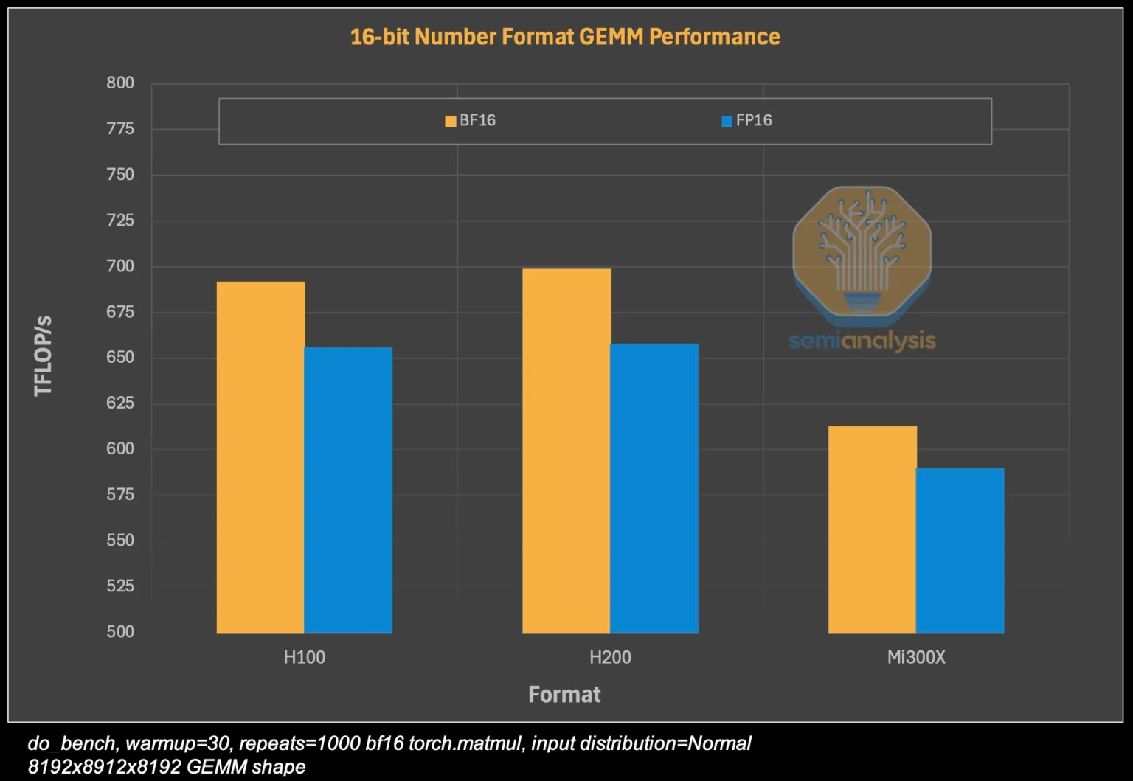
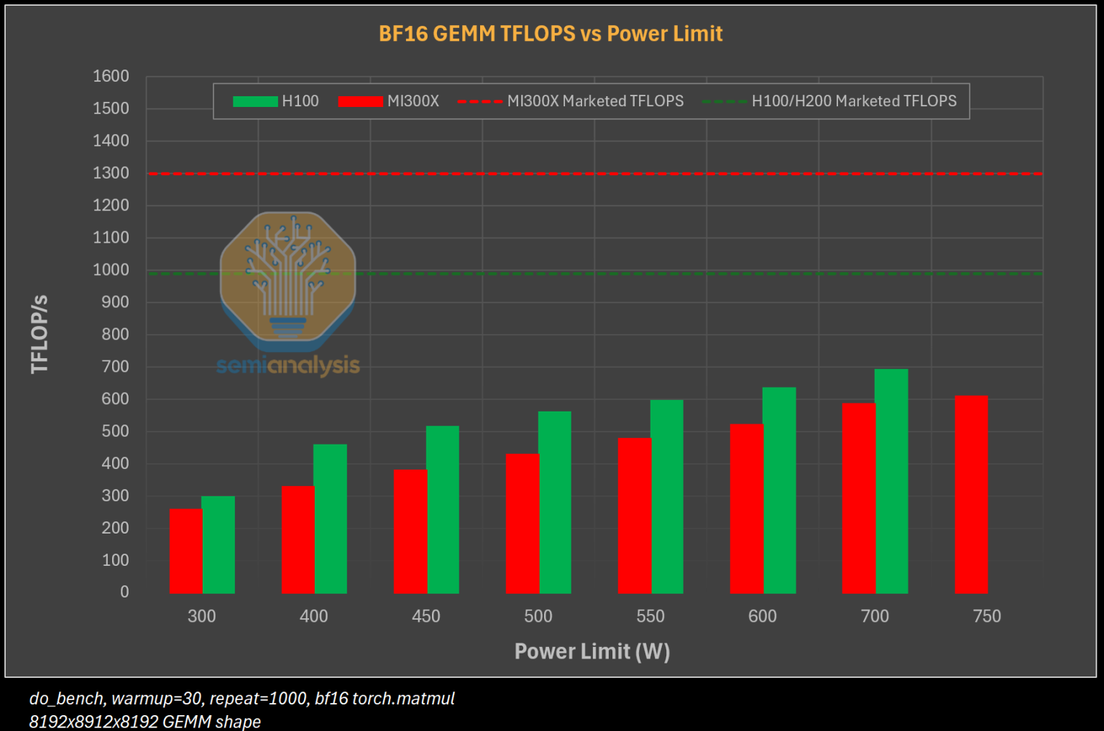
Performance in practice
In practice, the performance can be different (depending on software)
GPUs: observed FLOPS is ~2/3 of theoretical FLOPS

Slide 26
Chapter orange
Micro: precision

Slide 27
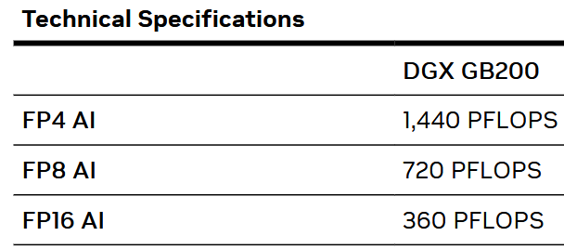
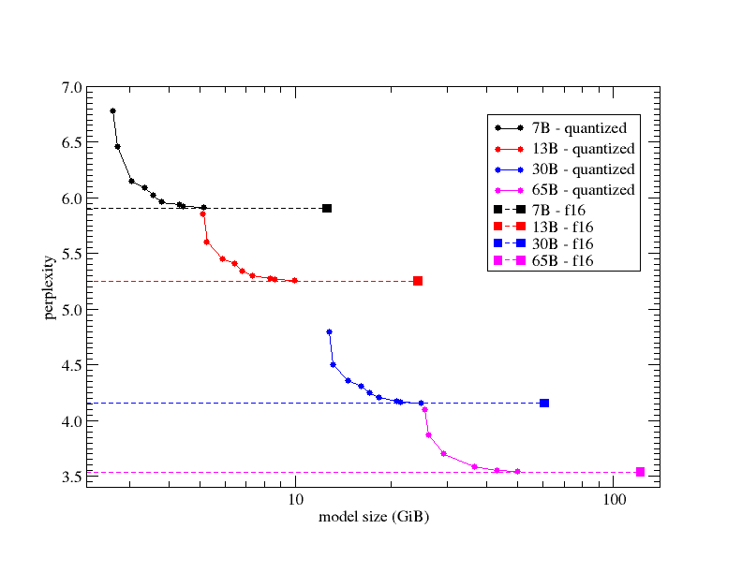
Critical innovations for AI
Matmuls are unreasonably efficient
Reduced precision (FP64 is dead)
double whammy of increased FLOPS and reduced memory footprint (many workloads are membw bound)

Slide 28
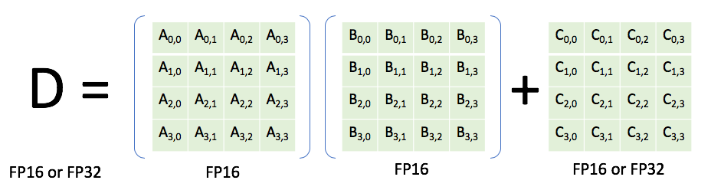
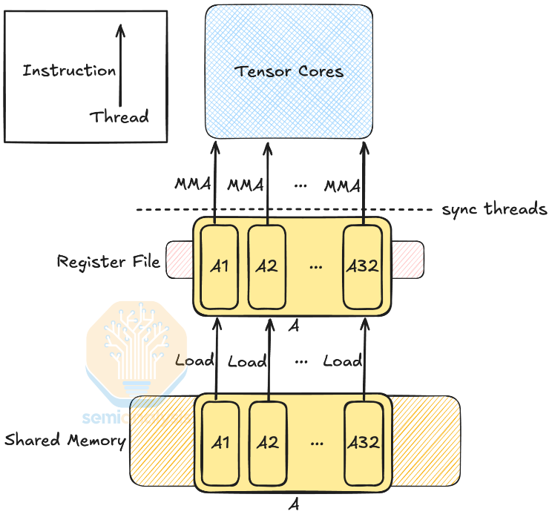
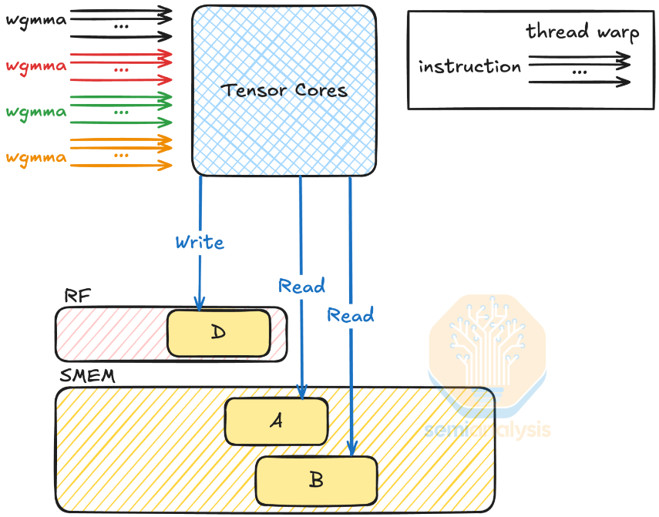
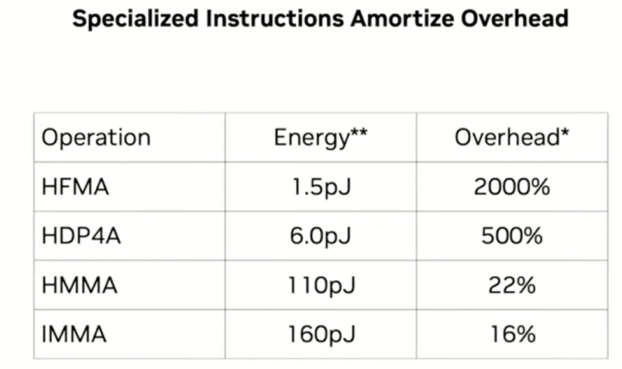
Tensor cores
Lower precision
Increasingly specialized
Pack as many instructions in one go to avoid instruction overhead, & avoid data movement
H=Half, I=Integer, FMA=Fused Multiply Add, DP=Dot Product, MMA = Matrix Multiplication Add
Previously: Now:

Slide 29
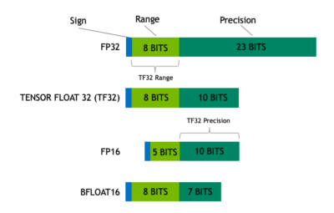
Lower precision for DL
Again: lower precision is a double-whammy of more efficient computation and loading less data
Generally, you are responsible for specifying a reduced precision: DL frameworks don’t do this automatically since it may impact your networks accuracy, convergence, etc
Mixed precision uses FP16. Reduced range causes (potential) need for gradient scaling to prevent underflows

Slide 30
Lower precision for DL
Again: lower precision is a double-whammy of more efficient computation and loading less data
Generally, you are responsible for specifying a reduced precision: DL frameworks don’t do this automatically since it may impact your networks accuracy, convergence, etc
TF32 tries to combine best of both worlds: range of an FP32 (no gradient scaling needed), but with reduced precision (for speedup & less memory)

Slide 31
Lower precision for DL
Again: lower precision is a double-whammy of more efficient computation and loading less data
Generally, you are responsible for specifying a reduced precision: DL frameworks don’t do this automatically since it may impact your networks accuracy, convergence, etc
Automatically used unless
Environment variable NVIDIA_TF32_OVERRIDE=0 is set
torch.backends.cuda.matmul.allow_tf32 = False and torch.backends.cudnn.allow_tf32 = False are set

Slide 32
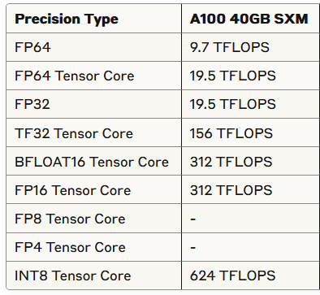
Lower precision for DL
Source: https://servicedesk.surf.nl/wiki/display/WIKI/Deep+Learning+on+A100+GPUs

Slide 33
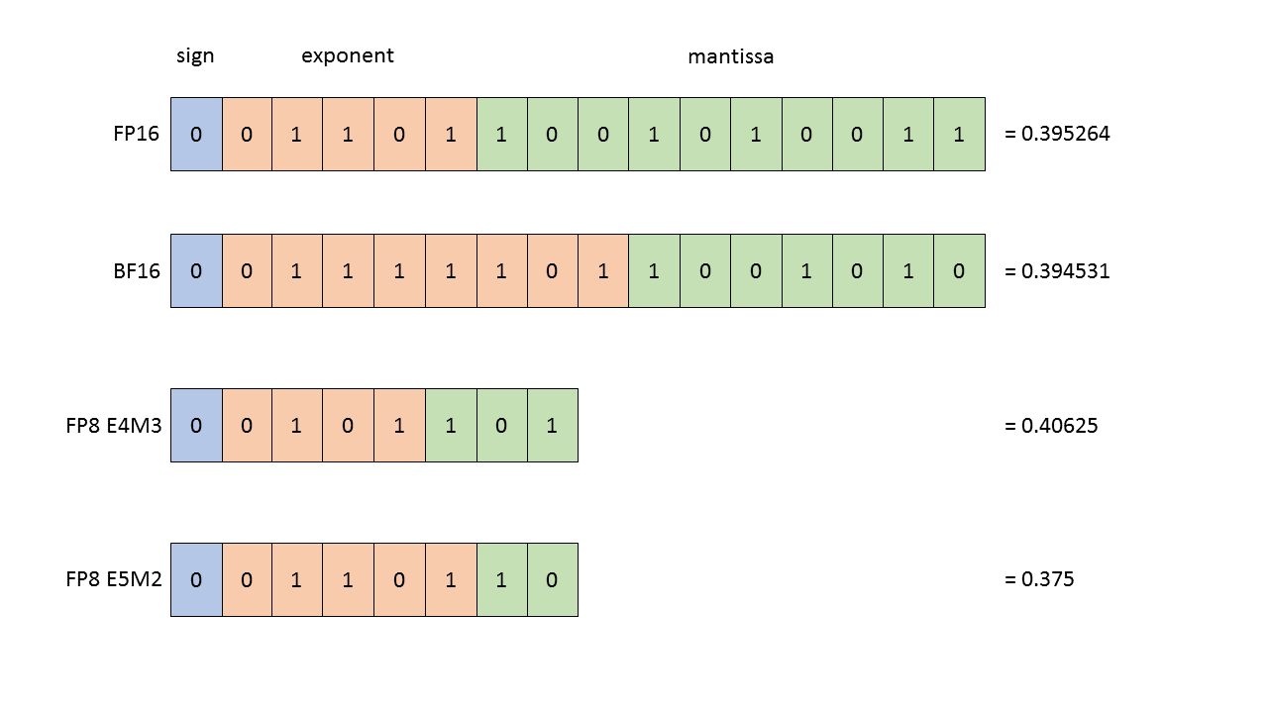
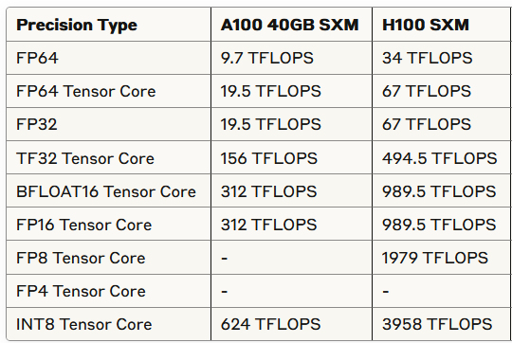
Nvidia Hopper (e.g. H100)
FP8 support
Transformer Engine for transformer specific improvements

Slide 34
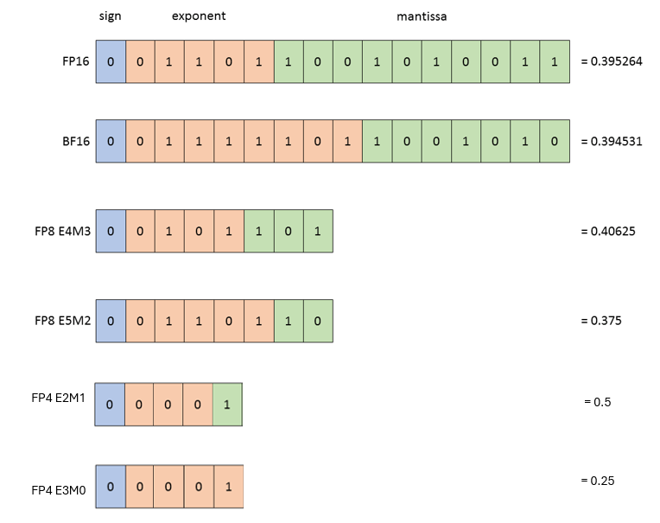
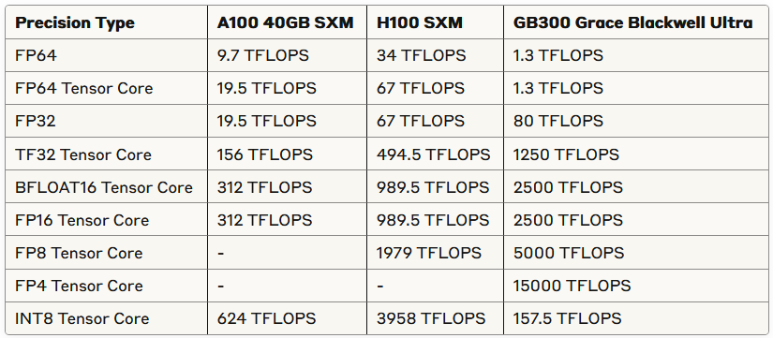
Nvidia Blackwell GPUs (e.g. B300)
FP4 support
Second-generation Transformer Engine

Slide 35
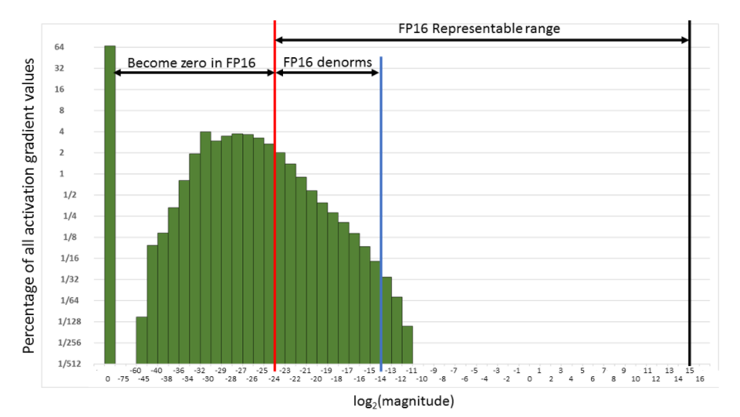
Thinking about the distribution of your data & model becomes even more important

Slide 36
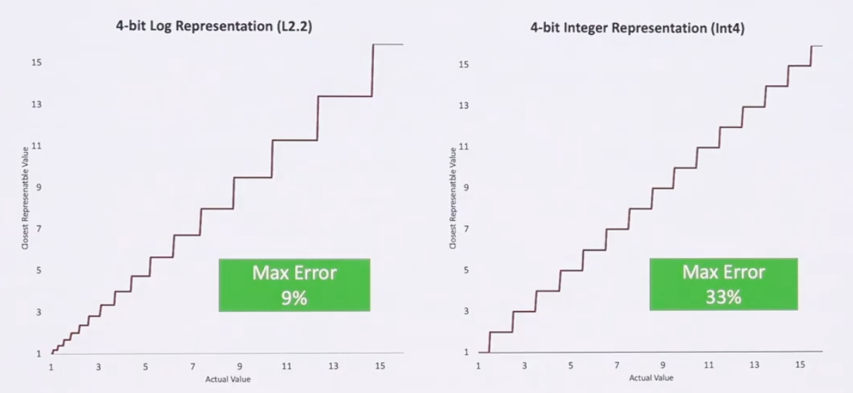
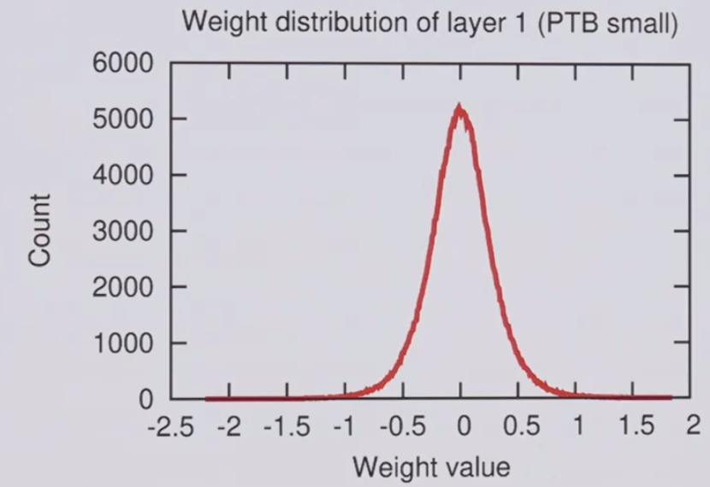
Thinking about the distribution of your data & model becomes even more important

Slide 37
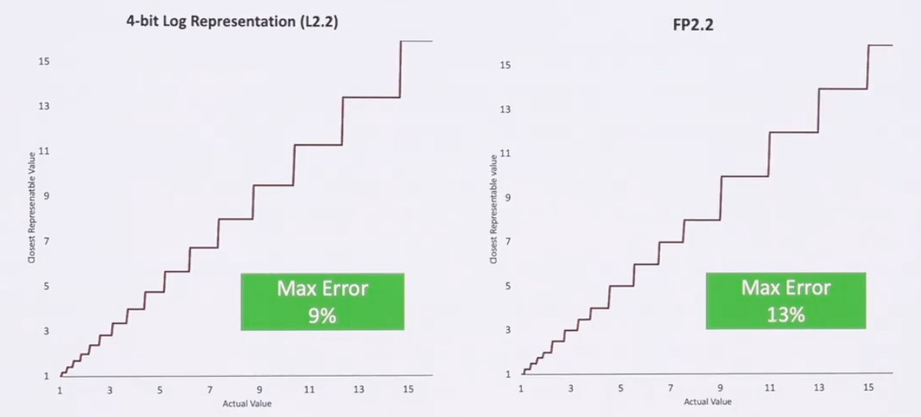
Thinking about the distribution of your data & model becomes even more important

Slide 38
Chapter orange
Continuing with the S’

Slide 39
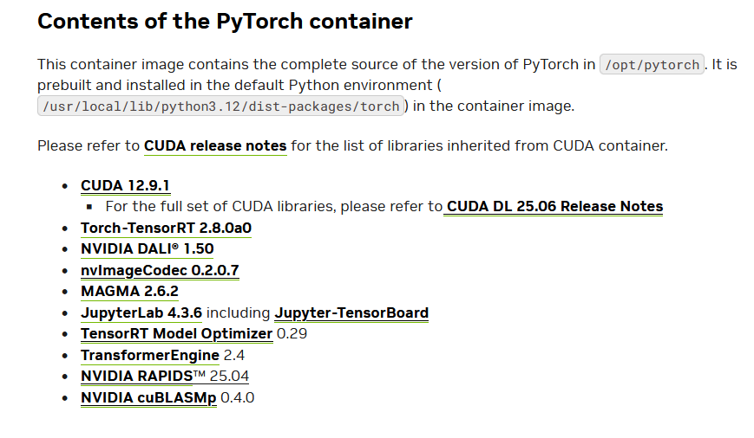
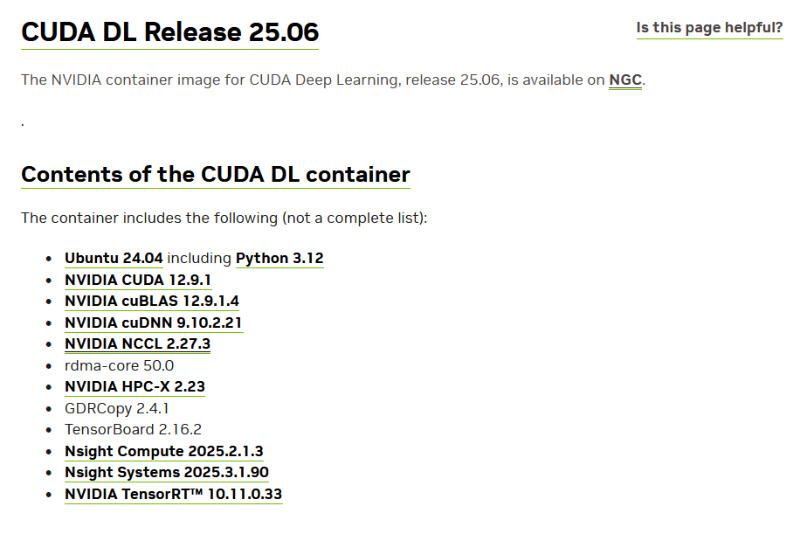
Second S: Software
PyTorch/TensorFlow vs Numpy
PyTorch and TensorFlow have GPU support, Numpy does not
Support for CUDA (Nvidia), ROCm (AMD), <insert exotic hardware here>?
E.g.: Intel SapphireRapids
IPEX: https://github.com/intel/intel-extension-for-pytorch
LUMI https://www.lumi-supercomputer.eu/
GDRDMA / SHARP / cuDNN / etc / etc / etc Not withstanding all the sys level dependencies
Support for lower precision
BFloat16, Float16? FP8? FP4?

Slide 40

Third S: Stack
Is my software compiled for my hardware
Pip install … ?
Module load PyTorch/2.1.2-foss-2023a-CUDA-12.1.1 ( so old :’( )
Use containers!
https://catalog.ngc.nvidia.com/orgs/nvidia/containers/pytorch
Again: Consider the hardware/platform that you’re using
GPU: Nvidia/CUDA? AMD/ROCm?
CPUs: AVX512?
Cerebras / Gaudi3 / etc. / etc.
PyTorch is crazy: https://github.com/pytorch/pytorch/tree/main/third_party
PyTorch has given up on generic software management
Ptrblck:” ”

Slide 41
Chapter orange
In conclusion

Slide 42
In conclusion
Fit your workload to your system
Think about your fundamental bottlenecks
Think about the bottlenecks of your system
Fit your system to your workload
Which is partly our job
But you should also think about this ☺

Slide 43
In practice: Snellius
We only have NVIDIA GPUs
72x4=288 NVIDIA A100
88x4=352 NVIDIA H100
Makes optimization a bit easier for you
You only need to spend a year sifting through documentation
https://servicedesk.surf.nl/wiki/display/WIKI/Deep+Learning+on+A100+GPUs
Or ask us... :)
Every EINF/NWO small grants has a default of 4 consultancy hours

Slide 44
Chapter orange
How does PyTorch deal with the three S’?

Slide 45
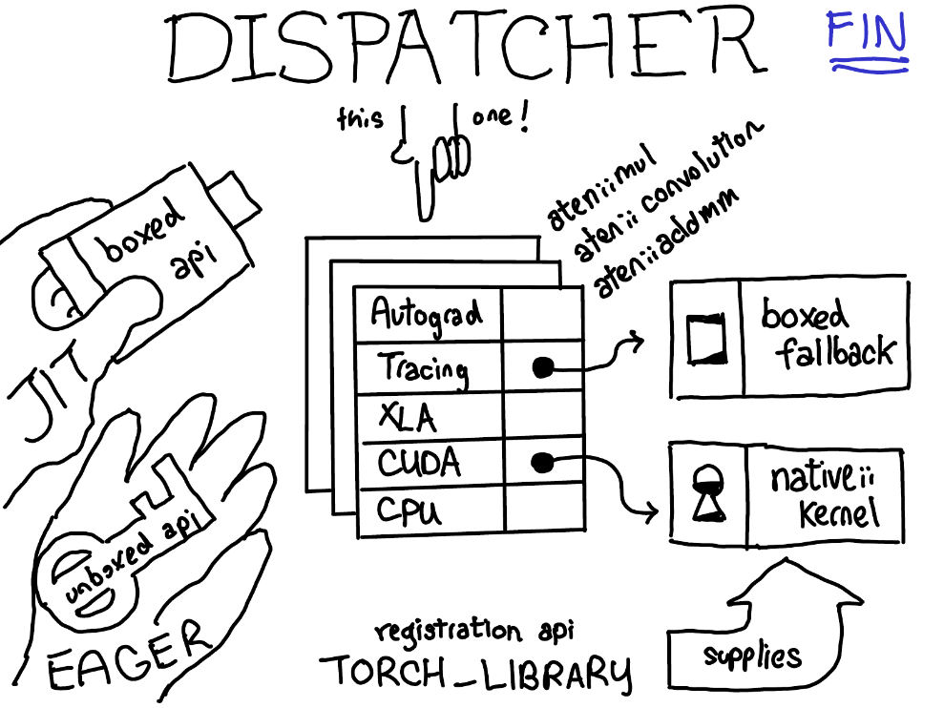
System + Software + Stack Wait ... so what happens in torch?
You call torch
E.g. scatter_add_ -> Message passing in Graph-NNs
(Manual) Dispatching
Torch (python) determines the most appropriate function to call
Dispatching
Torch (C++/CU) calls the CPU/GPU kernel
Dispatching
Low-level C++/CU library performs actual calculation
Dispatching
PyTorch Dispatcher:
http://blog.ezyang.com/2020/09/lets-talk-about-the-pytorch-dispatcher/

Slide 46
Chapter orange
Ask not “what can PyTorch do for me?”
Ask “What can I do for PyTorch?”

Slide 47

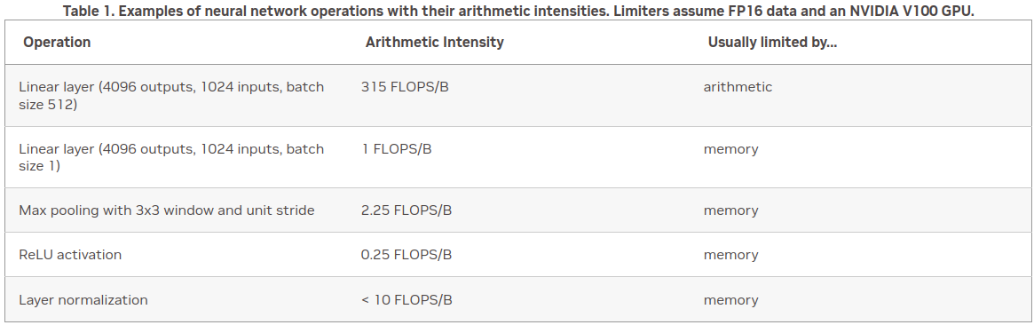
Rapidfire: implementation details
How fast do you want to go?
What is your goal?
Largest model possible?
Best validation performance?
Submit a paper to ISC ‘25?

Slide 48
Rapidfire: implementation details
Some useful resources:
https://pytorch.org/docs/stable/notes/cuda.html
https://docs.nvidia.com/deeplearning/performance/dl-performance-memory-limited/index.html
https://docs.nvidia.com/deeplearning/performance/index.html
Duncan: "You can take any piece of code, spend 6 months optimizing it, and then write a paper about it"

Slide 49
Level 0: "oh my god": torch.amp
If pytorch mixed precision isn’t working, probably you are doing something wrong
Gives you a free 2x+ speed boost
FP16 is probably better, BF16 is easier
FP8 is coming

Slide 50

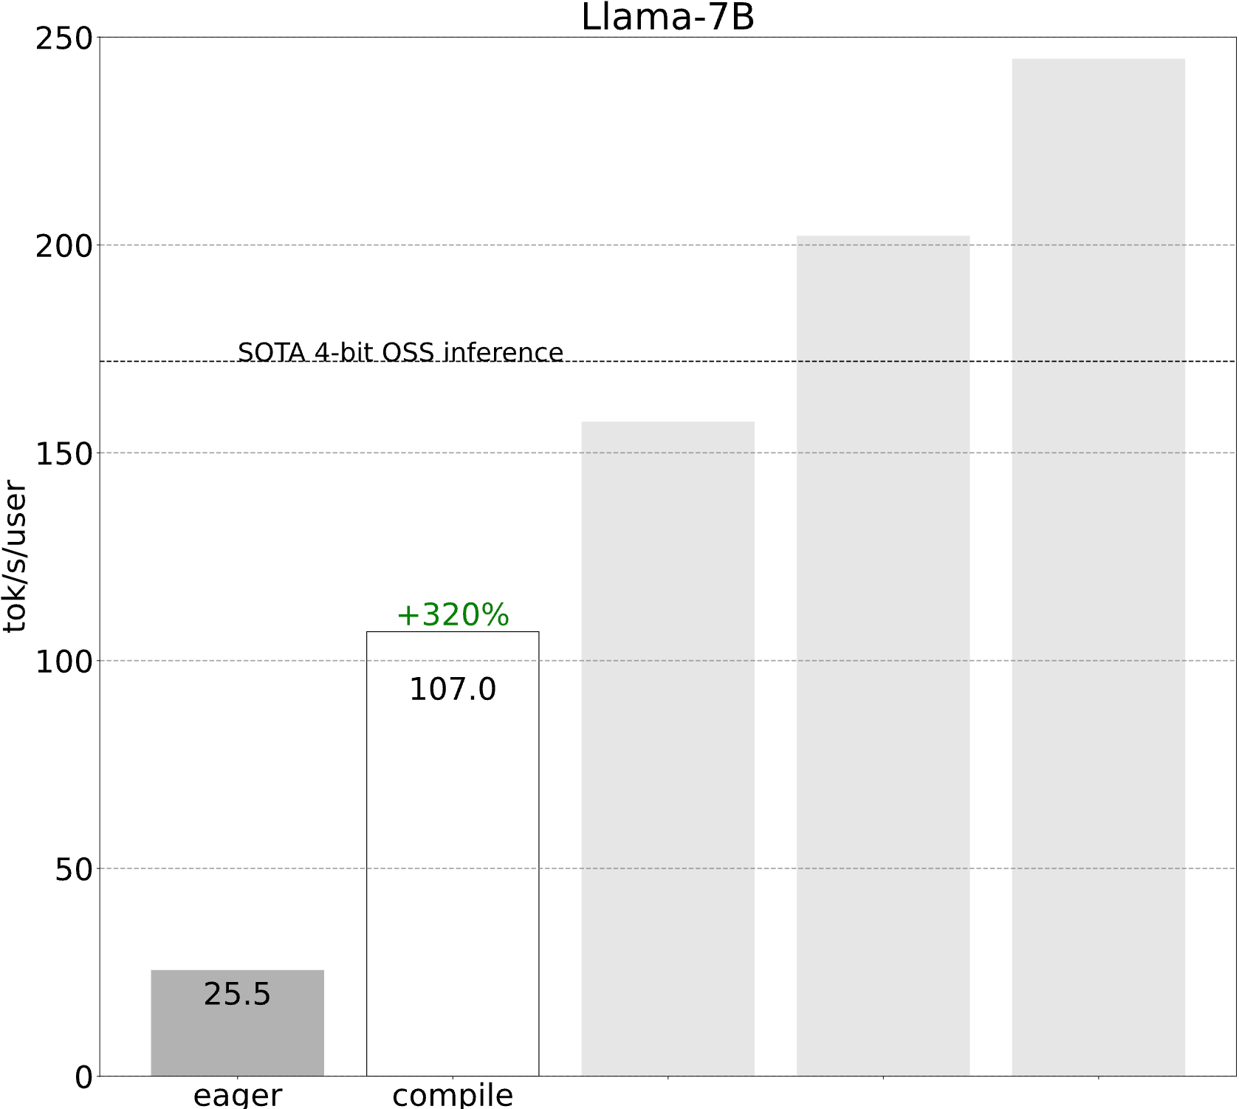
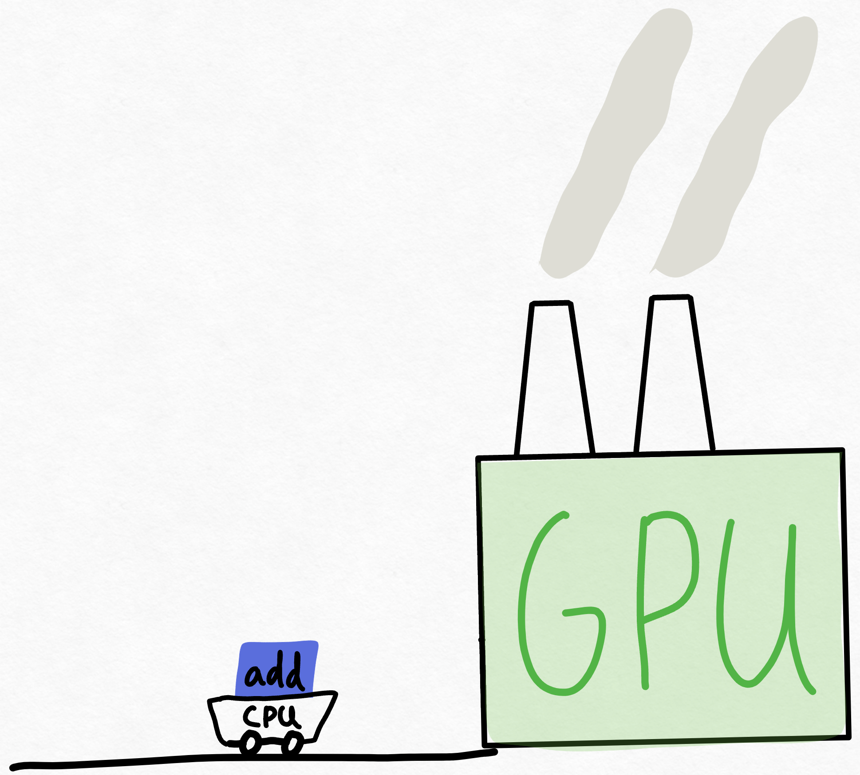
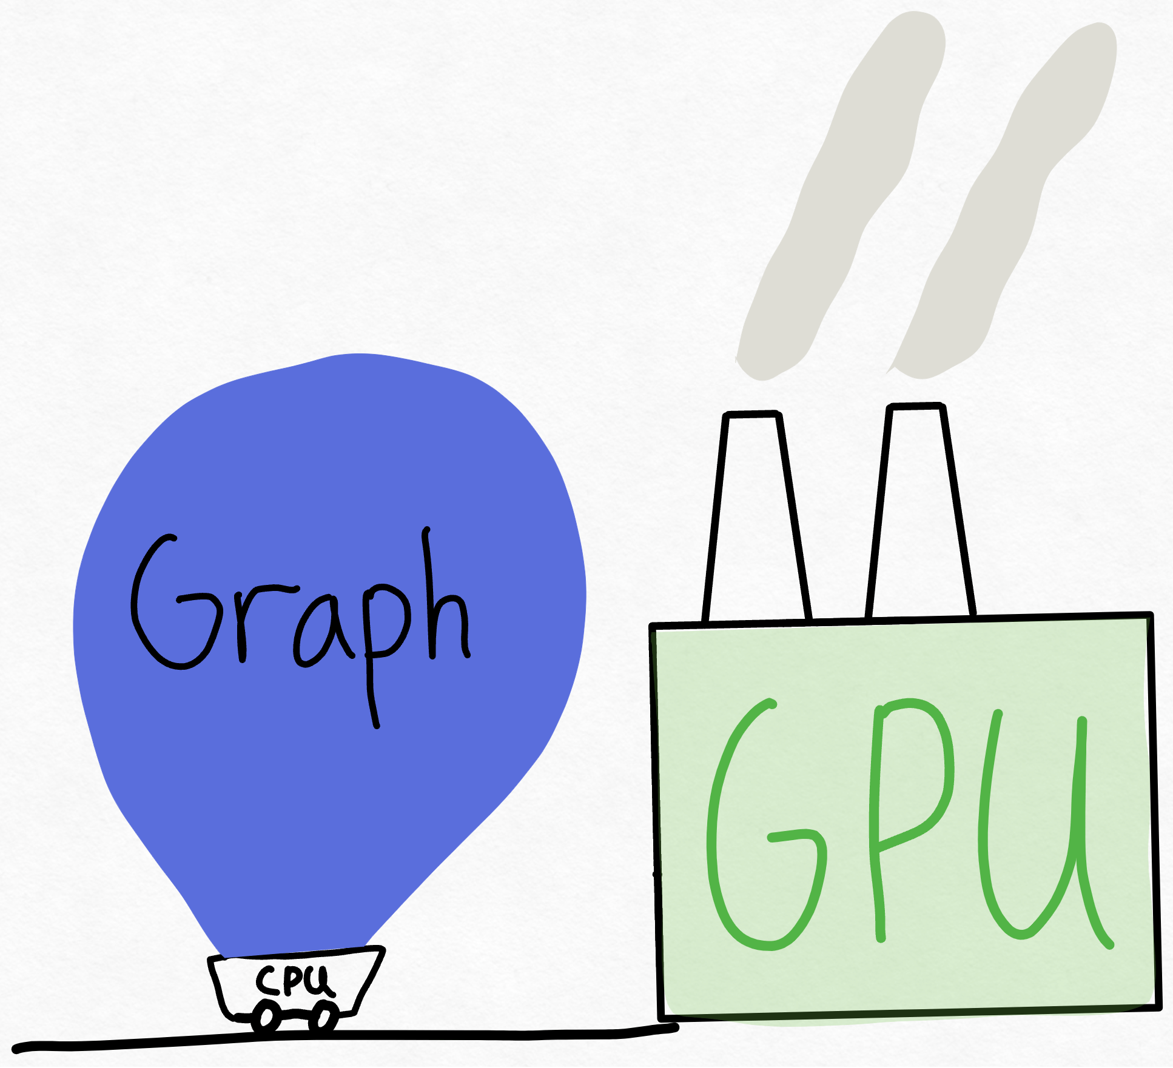
Level 0: "oh my god": torch.compile
1 CPU core is pinned to 1 GPU (used to be worse)
CPU cannot keep up with the giant that is the GPU
Still (somewhat) need to know the magic incantation:

Slide 51
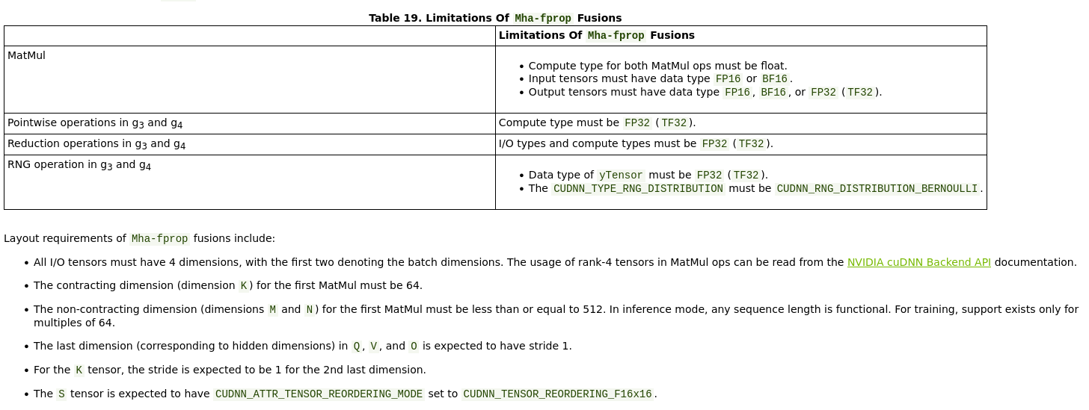
Level 1: Shouldn't impact model convergence:
Make sure every single layer/input/operation is done on multiples of 2, and probably preferable multiples of 8

Slide 52
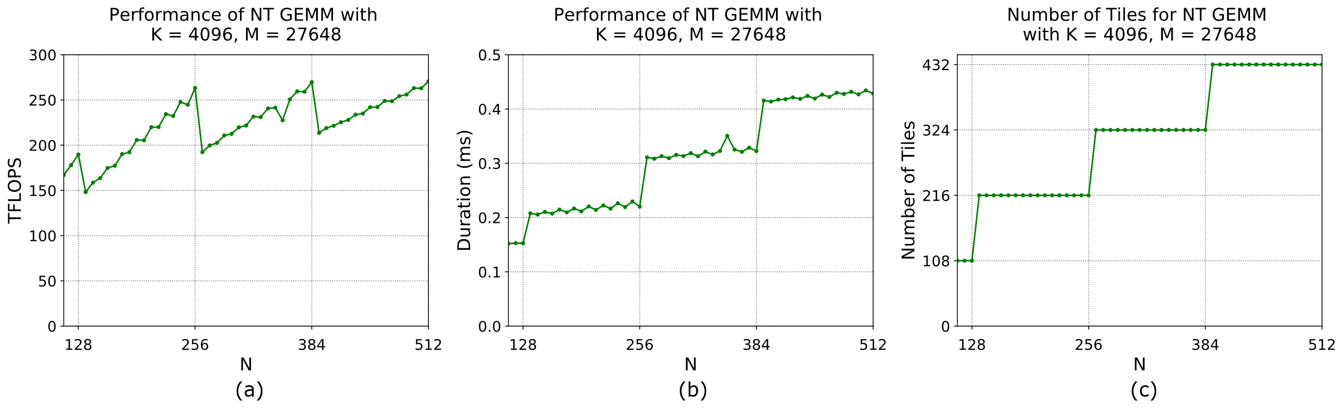
Level 1: Shouldn't impact model convergence:
Make sure every single layer/input/operation is done on multiples of 2, and probably preferable multiples of 8

Slide 53


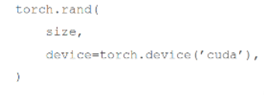
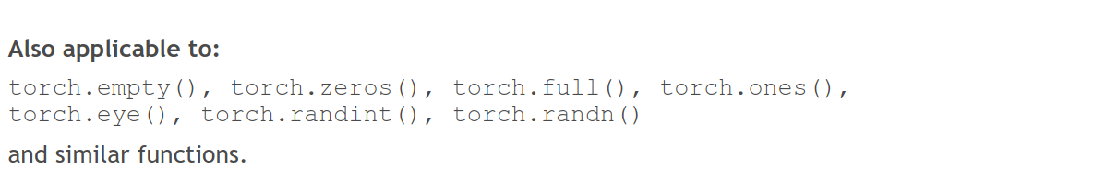
Level 1: Shouldn't impact model convergence:
Avoid CPU-GPU sync
Create tensors directly on the device
✅

Slide 54
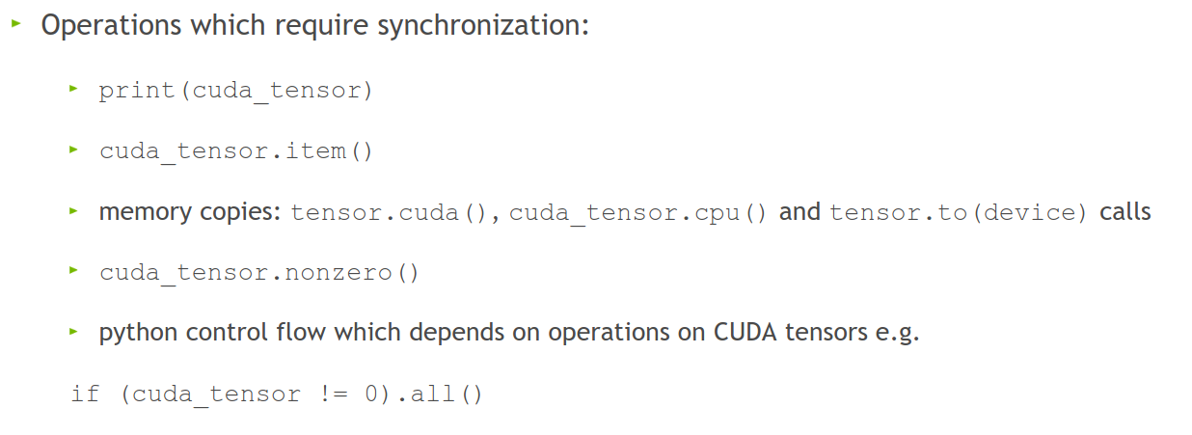
Level 1: Shouldn't impact model convergence:
Avoid doing these inside a training loop if possible:
This forces PyTorch to copy data from GPU to CPU, slowing performance.

Slide 55
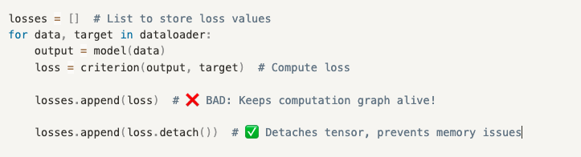
Level 1: Shouldn't impact model convergence:
Don't aggregate tensors which still require grad, e.g.: losses.append(loss) (:o)
instead, detach (loss.detach())
Each loss in losses.append(loss) stores the entire computation graph. PyTorch stores extra gradients unnecessarily!
detach() creates a new tensor with the same values but removes the gradient tracking.

Slide 56
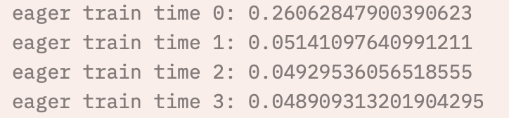
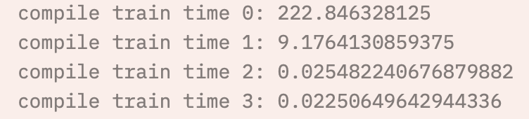
Level 1: Shouldn't impact model convergence:
There is little reason not to use TensorFloat32 ☺
torch.backends.cuda.matmul.allow_tf32 = True
The default in PyTorch (silently)
torch.set_float32_matmul_precision('high')
torch.backends.cudnn.benchmark = True
Empirically benchmarks to find fastest method
Align bytes: multiples of 2, 8, 1024
DNN libraries want nicely aligned memory
torch.channels_last
Helps with memory alignment and reduces cache misses
Compile: PyTorch 2.0
Big speedup, but sensitive to implementation
Helps maintain accuracy in cases where TF32 might introduce minor errors
Stores images in NHWC format instead of NCHW (optimizes GPU cache usage)

Slide 57

Level 2: Danger zone
Lower precision (FP16 or BF16) for matrix reductions instead of higher precision (FP32, advised). Can cause numerical instability!
torch.backends.cuda.matmul.allow_fp16_reduced_precision_reduction = True
Lol:
torch.backends.cuda.matmul.allow_bf16_reduced_precision_reduction = True
Torch.set_float32_matmul_precision('medium')
Cast model and data to (B)Float16 before the forward pass
We're not supposed to...but:
trades some accuracy for faster compute. Can affect model convergence
Forces all computations to use lower precision, instead of letting autocast() to choose

Slide 58
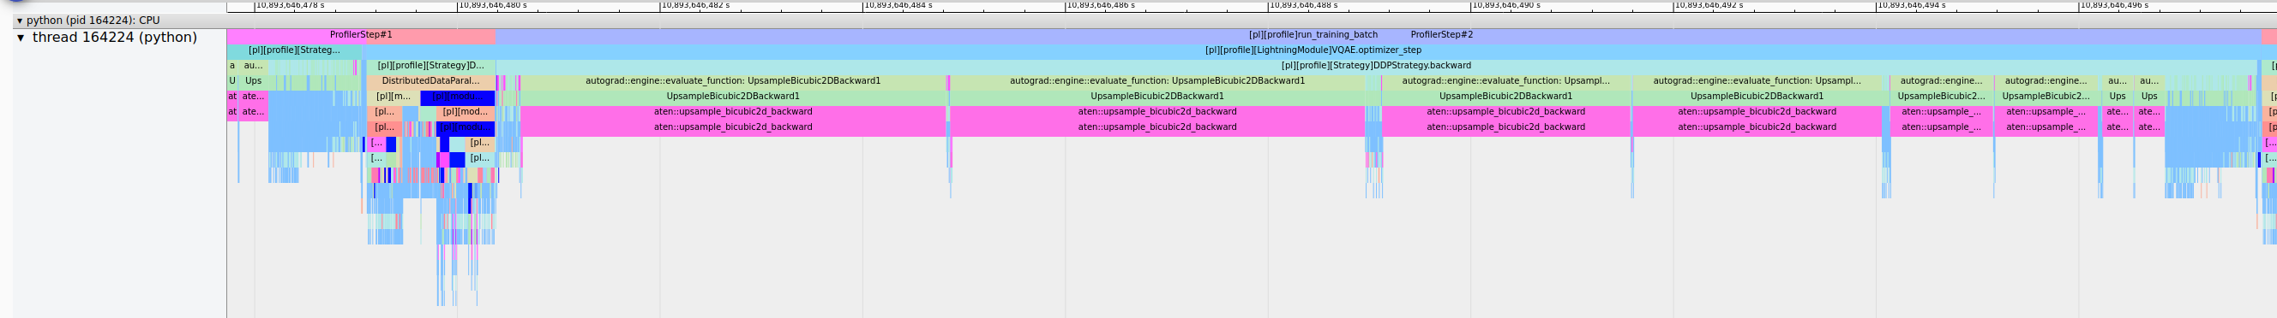
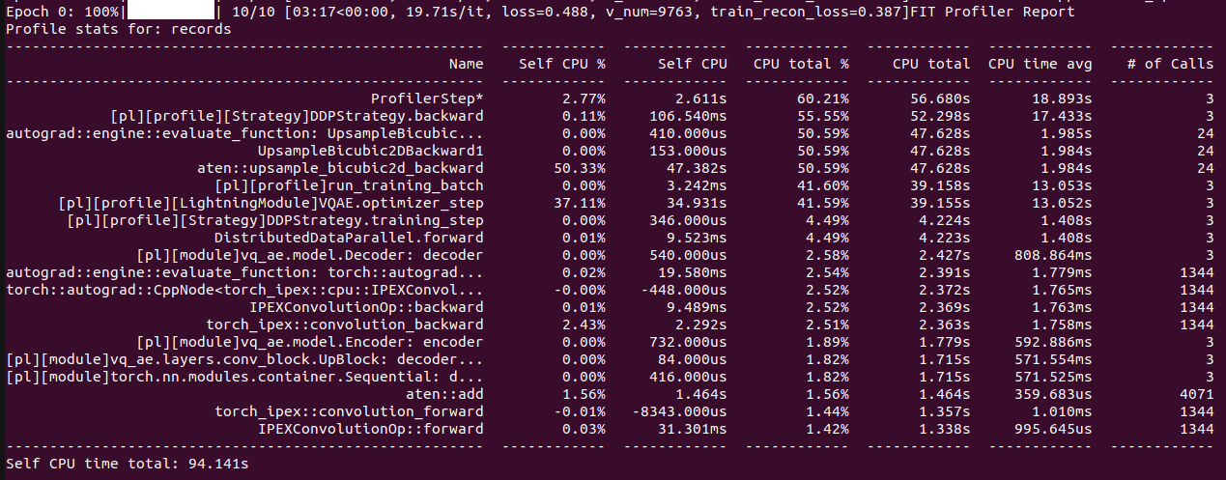
Or: Change your model
Worst case scenario:

Slide 59
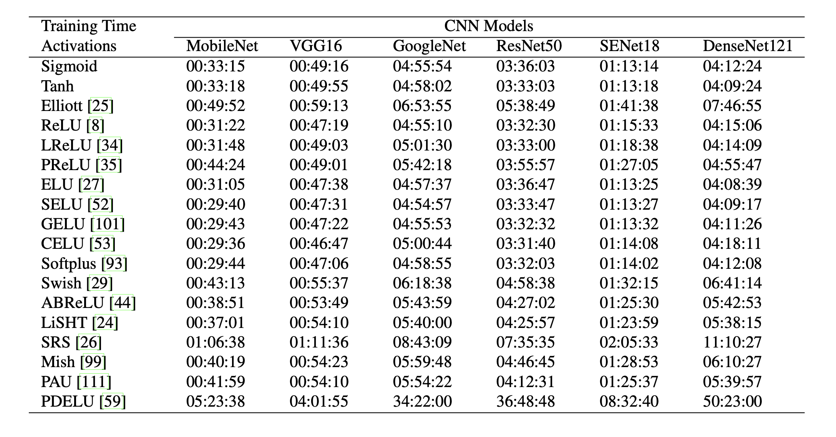
Or: Change your model
Change model architecture to improve performance characteristics, e.g.:
Use LoRA for fine-tuning
Use pre-trained model aka zero shot (@train VAE for latent space creation or use pre-trained model)
E.g. Llama, DINOv2
Incorporate dataloading operations into the model instead of CPU pipeline
ViT vs CNN vs GNN
Change non-linearities
Multiples of 2,8,1024
Channels
Hidden size
Vocab size
Batch size
Input resolution/sequence length
Everything
For transformers:
Patching
Masked attention

Slide 60
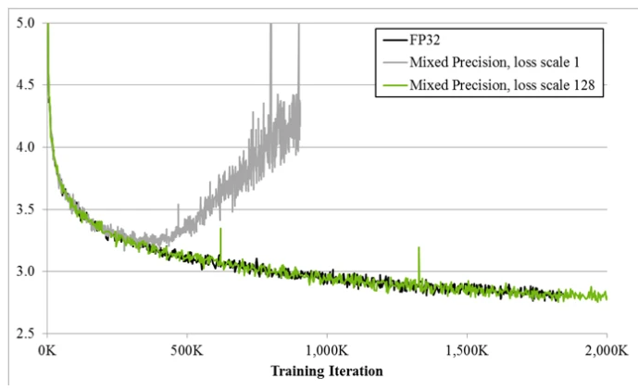
Always
Have a baseline
Check convergence statistics

Slide 61

Profile
Get a grip on your model’s performance
Profile
Profile
Profile

Slide 62
Chapter orange
On that note: Profiling!

Slide 63
Profile
Notebook available at https://github.com/SURF-ML/HPML-course-materials/blob/august2025/Day2/notebooks/PyTorch_profiling.ipynb
Reference traces are in https://github.com/SURF-ML/HPML-course-materials/tree/august2025/Day2/notebooks/logs
``` python3 -m venv venv source venv/bin/activate pip install git+https://github.com/pytorch/kineto.git#subdirectory=tb_plugin git clone --depth=1 https://github.com/SURF-ML/HPML-course-materials.git tensorboard --logdir HPML-course-materials/Day2/notebooks/logs/ ```

Slide 64
Chapter orange
Bonus: AI Factory

Slide 65
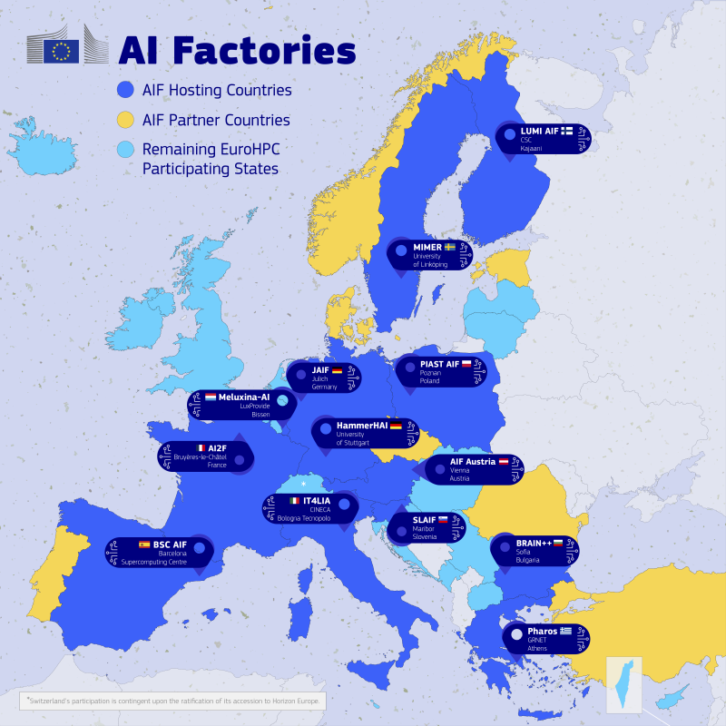
AI factories recap
Initiative by the EU to close the AI-gap to our ‘friends’ to the west and to our ‘friends’ to the east
Bootstrapping AI development and AI uptake in Europe
Budget ‘fluid’; up to EC discretion So far ~€1.5 billion granted Up to €200 million matched per site
AI Gigafactories also announced: ~€20 billion available
‘Create AI aligned with EU values’
We want to build an AI factory, ready Q3 2027 in The Netherlands

Slide 66
AI factories recap
We want to build an AI factory, ready end of 2026 in The Netherlands
Seems Lithuania and the Netherlands are competing in the same round ☺ https://www.madeinvilnius.lt/en/business/Vilnius-market/The-ambition-is-to-have-one-of-the-most-powerful-di-centers-in-Europe-in-Lithuania./

Slide 67
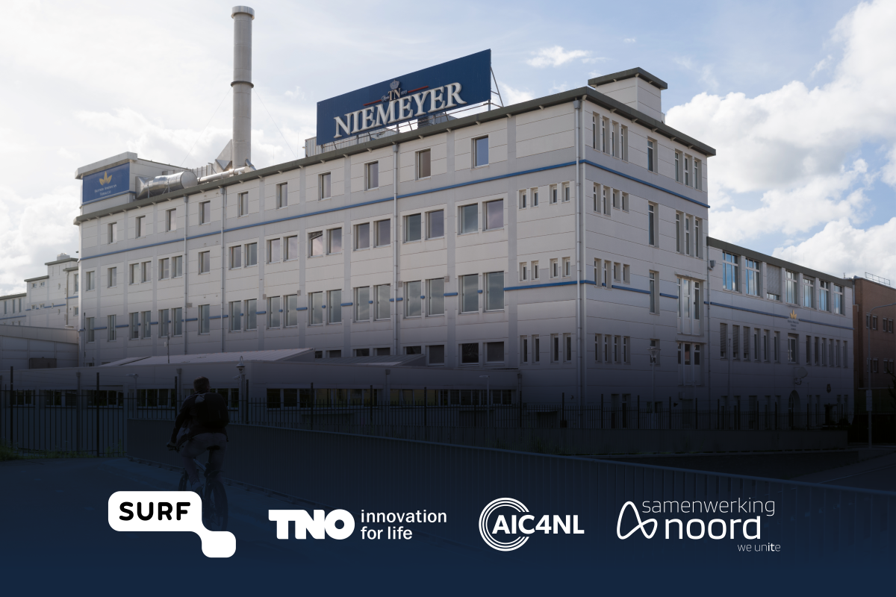

AI factories setup
Technically:
“AI factory” -> expertise center
“AI facility” -> supercomputer
“AI factory” sometimes means both
Dutch AIF:
200M euro total budget
1/3rd of the budget towards facility
Operational Q3 2027

Slide 68
Do we even need an AI factory?
You tell me ☺
Current (national) hardware is not sufficient for current & next-gen workloads
National perspective:
Data sovereignty & country borders are important (UMC’s)
Foster national ecosystem

Slide 69
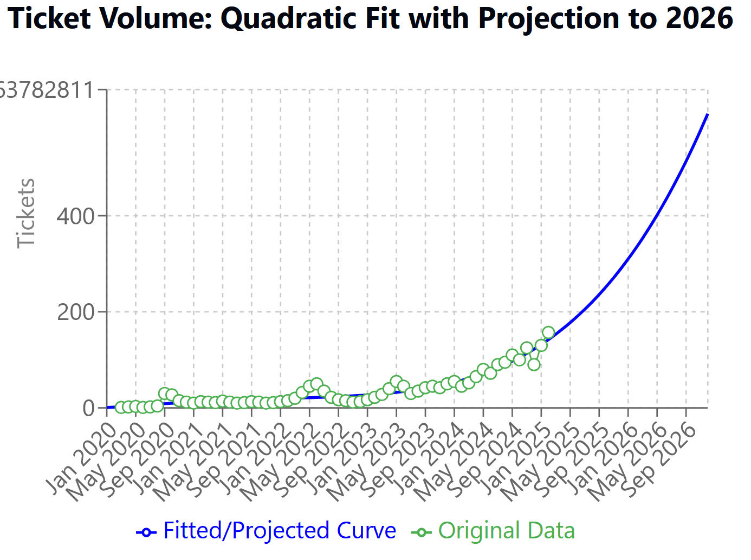

Do we even need an AI factory?
Our perspective:
On average, the HPML teams gets 3-4 tickets per day regarding AI
Application support and compute resource requests, on average taking 1-4hrs (one person fulltime)
AI says we practically get infinite tickets a day at the end of 2026 (Actually ~15, extrapolated, 5 people fulltime)
Not withstanding larger application support
Industry perspective:
AI has firmly taken over the HPC world
“AI is the new HPC” -> AMD: “in 2025 ~30M datacenter GPUs datacenter were sold, of which ~500k for HPC applications”
Public perspective:
Data and compute sovereignity is of paramount importance
AI factories and Gigafactories

Slide 70
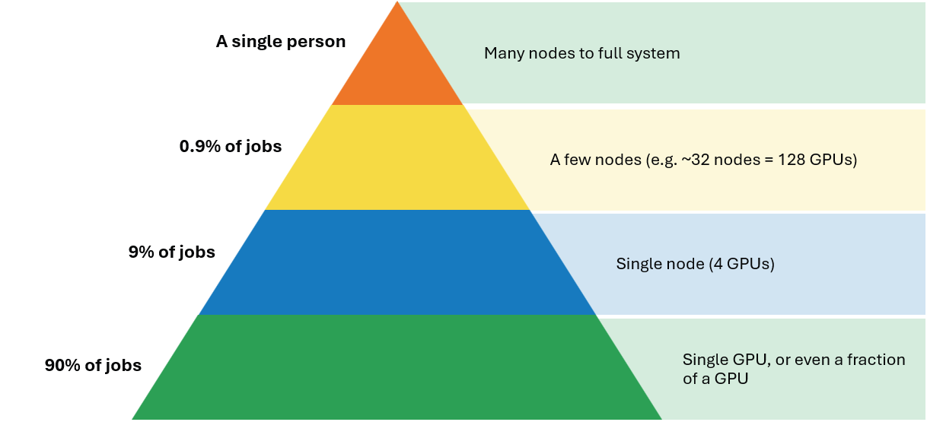
Who to design the AI factory for?
50/50 split between EuroHPC JU and The Netherlands
EuroHPC jobs almost per definition are large applications
Dutch Research?
Primarily ‘just’ need many GPUs, less emphasis on large jobs
SME?
Data security very important
More inference / always online type jobs
Public?
Again, data security
Small jobs?

Slide 71
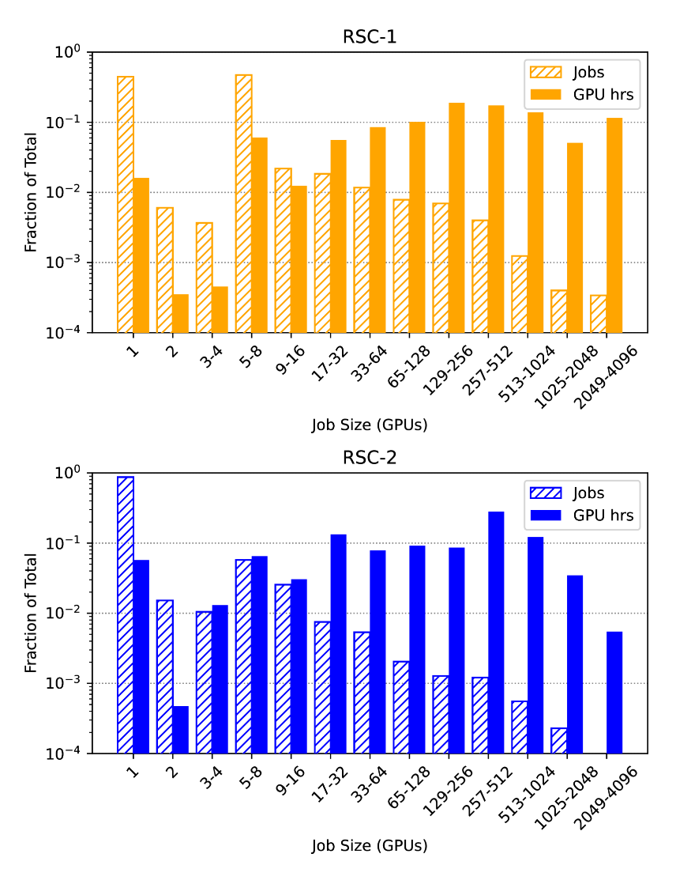

Who to design the AI factory for?
Again, what to optimize for?
Do we want/need 10 vans or 1 Ferrari?
Critical scale for certain training runs (‘small’ Large-LMs)
Probably in the order of ~2k GPUs IFF tightly coupled (https://arxiv.org/pdf/2412.19437)
Source: https://arxiv.org/html/2410.21680v1

Slide 72
Critical innovations for AI
Matmuls are unreasonably efficient
Reduced precision (FP64 is dead)
double whammy of increased FLOPS and reduced memory footprint (many workloads are membw bound)
High-bandwidth domains:
order-of-magnitude faster interconnect than current interconnect
Enables model sharding (FSDP, Tensor-Parallel, MoE) Bigger models are simply better (given enough data)
Pods

Slide 73
So where does that leave us?
Disclaimer time:
None of this is final
Good ideas are always appreciated
Fully dependent on funding
HW design TL;DR: (Goes without saying) optimize both for capability and cost-effectiveness
Exascale 16-bit TFLOPS
Power envelope: 5MW
Compute: as many big AI GPUs as possible
Storage: tiered
Network: optimized

Slide 74
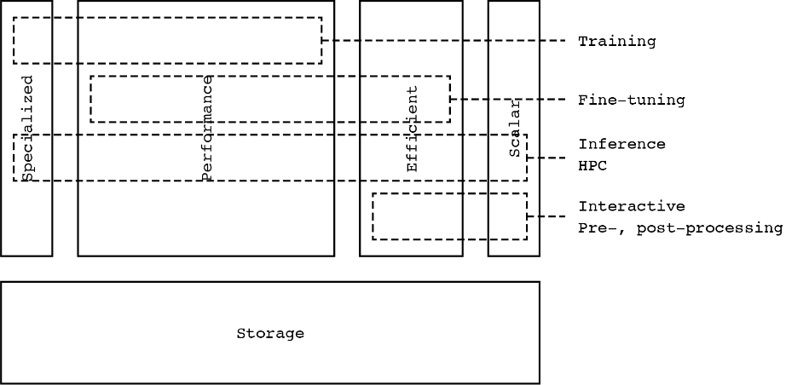
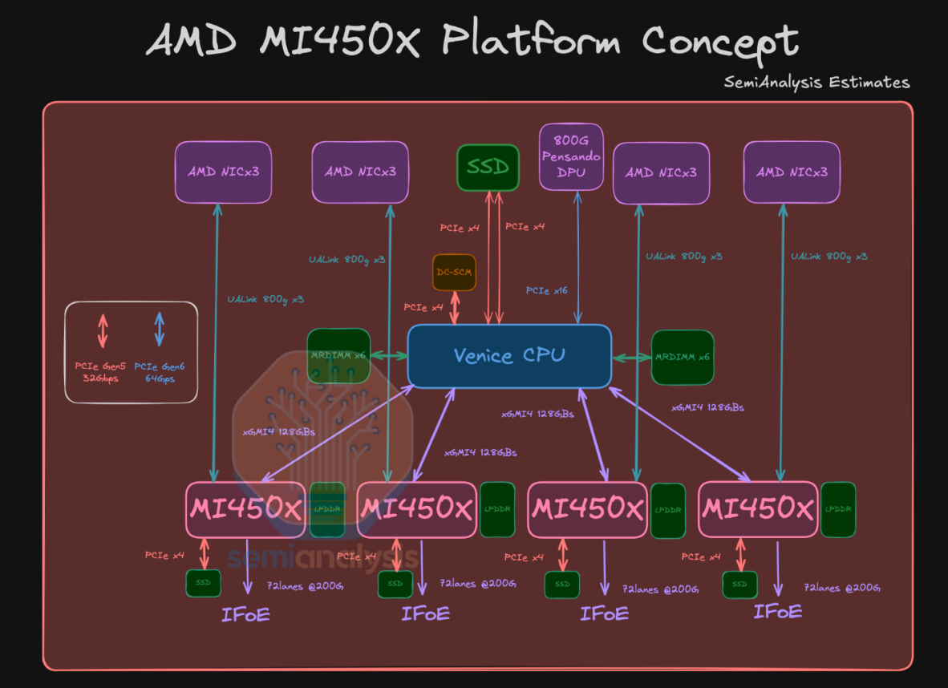
Compute
Performance partition: 1k GPUs
Big GPUs, Big interconnect PFLOPS per GPU, 200GB+ HBM VRAM
Focus on training or big-model inference
120-240kW+ per rack
Efficient partition
Cost effective GPUs
No interconnect
Online inference
CPU partition
Pre/Post processing and CPU-based ML
Specialized partition
Exotic hardware for specific use cases

Slide 75
Storage
Tiered:
‘Hot’ storage: all-NVMe SSD scratch
ML workloads are very often continuous-load high-IOps
No node-local storage! (?)
‘Warm’ storage: performant spinning disk parallel fs
Backbone of the system
‘Lukewarm’ storage: object store
Data ingress, and integration with cloud and other EU systems
‘Cold’ storage: tape
Not generally available to users, but used as cost-effective backend for data storage and archival purposes

Slide 76
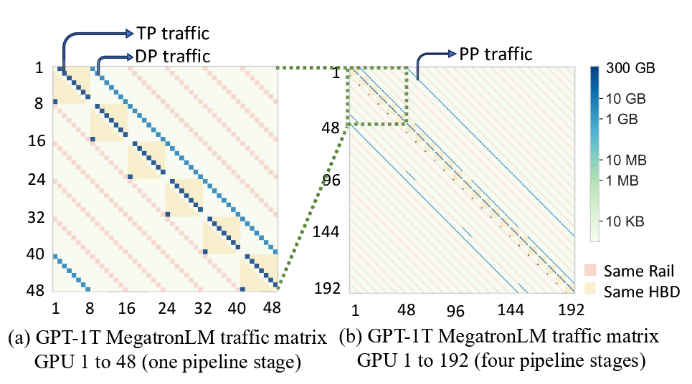
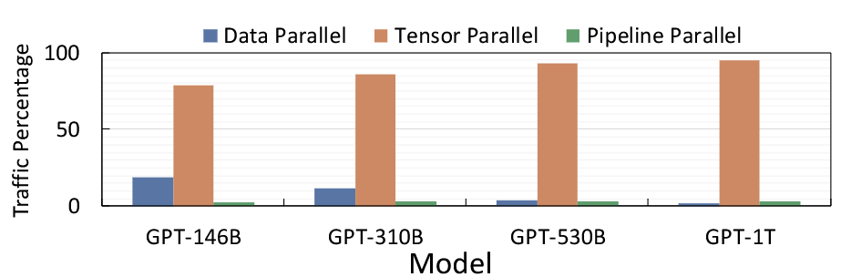
Interconnect
Probably 4-8 GPU’s per node all-to-all
Memory is large enough to not need Pods
Big ‘scale-out’ network is probably not necessary
We are too small for that
E.g.: two supplementary 800Gbps NICs per node for dataloading or scale-out

Slide 77



Interconnect
All-copper ‘scale-up’
8Tbps+ per GPU BW, connected directly to the GPU
For reference: Snellius GPU nodes = 2x200Gpbs divided over 4 GPUs
Single layer of switches connect up-to 256 GPUs
Big ‘scale-out’ network is probably not necessary
We are too small for that
E.g.: single supplementary 800Gbps NIC per node for dataloading or scale-out

